Slide 1
FACE IDENTIFICATION
19PD29 - SAI KRISHNA
19PD38 - SWATHI PRATHAA

Slide 2

Inspiration:
FACE UNLOCK FEATURE IN MOBILE PHONES!

Slide 3
Problem Statement:
Identify a person after their face has been registered in the database.
The registered faces will not be present in the training corpus.
Multiple people can be registered on the go.
Model should be lightweight and able to run on mobile devices.
Notes:
The user just looks at the phone as he\she would normally do, and then slowly rotates the head following a circle, thus registering the face from different poses.
The neural networks powering FaceID are not just performing classifications

Slide 4
“…the neural networks powering FaceID are not simply performing classification”
Notes:
FaceID is powered by a siamese-like convolutional neural network that is trained “offline” by Apple to map faces into a low-dimensional latent space shaped to maximize distances between faces of different people, using a contrastive loss.

Slide 5
Idea behind FaceID:
Performing classification, for a neural network, means learning to predict if the face it has seen it’s the user's one or not.
So, it should use some training data to predict “true” or “false”, here this approach would not work.
First, the network should retrain from scratch using the new obtained data from the user’s face.
This would require a lot of time, energy consumption, and impractical availability of training data of different faces to have negative examples (little would change in case of transfer learning and fine tuning of an already trained network).

Slide 6
Idea behind FaceID:
Instead, we can map faces into a low-dimensional vector space shaped to maximize distances between faces of different people, using a contrastive loss.
This way we can use a trained model to identify faces simply by storing the user’s face vector representation and compare it with all future faces
This can be achieved using Siamese Neural Network

Slide 7
Siamese neural network:
A siamese neural network is basically composed by two identical neural networks that also share all the weights.
This architecture can learn to compute distances between particular kind of data, such as images.
The idea is to pass couples of data through the siamese networks, the network maps it in a low dimensional feature space, like a n-dimensional array, and then train the network to make this mapping so that data points from different classes are as far as possible, while data points from the same class are as close as possible.
In the long run, the network will learn to extract the most meaningful features from data, and compress it into an array, creating an meaningful mapping.
Notes:
A Siamese Neural Network is a class of neural network architectures that contain two or more identical subnetworks. ‘identical’ here means, they have the same configuration with the same parameters and weights. Parameter updating is mirrored across both sub-networks. It is used to find the similarity of the inputs by comparing its feature vectors, so these networks are used in many applications.It uses only a few numbers of images to get better predictions.
Traditionally, a neural network learns to predict multiple classes. This poses a problem when we need to add/remove new classes to the data. In this case, we have to update the neural network and retrain it on the whole dataset. Also, deep neural networks need a large volume of data to train on. SNNs, on the other hand, learn a similarity function. Thus, we can train it to see if the two images are the same (which we will do here). This enables us to classify new classes of data without training the network again.
https://towardsdatascience.com/a-friendly-introduction-to-siamese-networks-85ab17522942

Slide 8
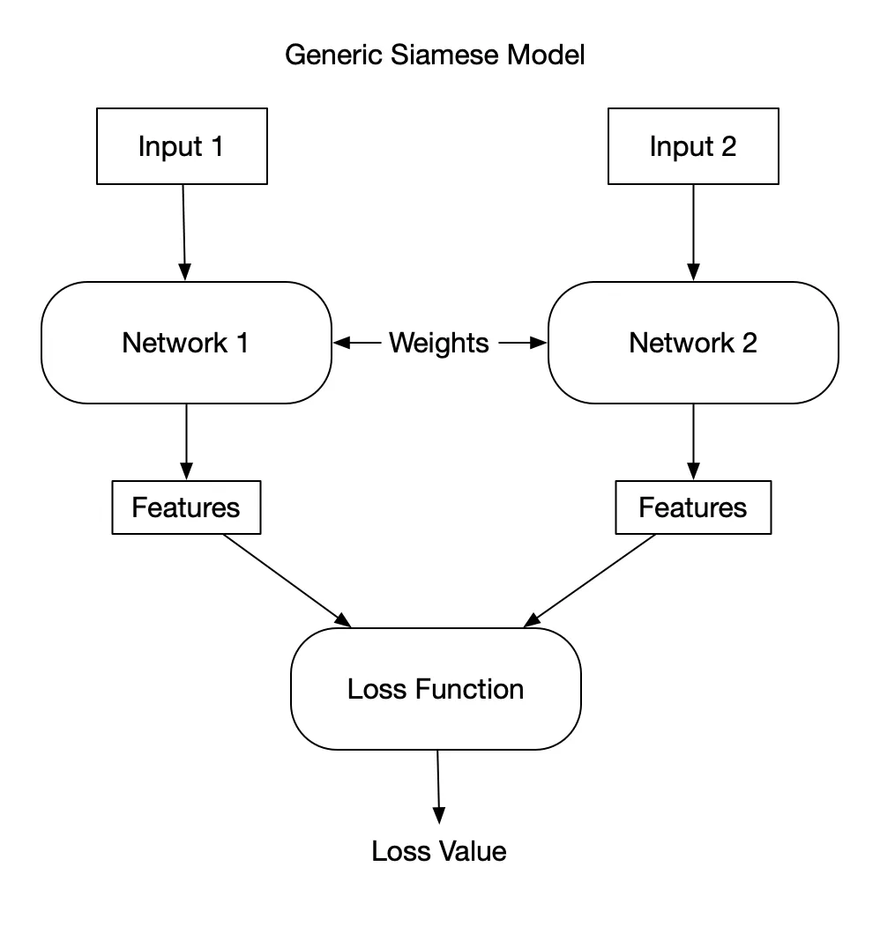

Slide 9
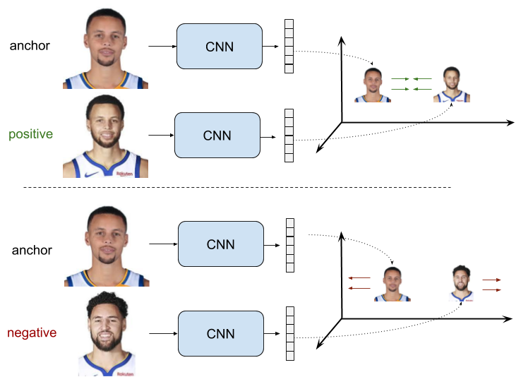

Slide 10
Pros of Siamese Networks:
More Robust to class Imbalance: With the aid of One-shot learning, given a few images per class is sufficient for Siamese Networks to recognize those images in the future
Nice to an ensemble with the best classifier: Given that its learning mechanism is somewhat different from Classification, simple averaging of it with a Classifier can do much better than average 2 correlated Supervised models (e.g. GBM & RF classifier)
Learning from Semantic Similarity: Siamese focuses on learning embeddings (in the deeper layer) that place the same classes/concepts close together. Hence, can learn semantic similarity.

Slide 11
SqueezeNet Architecture:
A deep convolutional neural network (CNN)
Compressed architecture design
Model contains relatively small amount of parameters
Achieves AlexNet-level accuracy on ImageNet dataset with 50x fewer parameters.
AlexNet is a leading architecture for any object-detection task and may have huge applications in the computer vision sector of artificial intelligence problems
Notes:
https://stephan-osterburg.gitbook.io/coding/coding/ml-dl/tensorfow/untitled-2/squeezenet-architecture-design
https://medium.com/@avidrishik/squeezenets-architecture-compressed-neural-network-7741d24ca56f

Slide 12
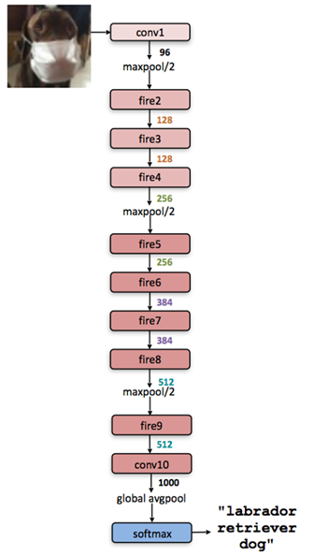
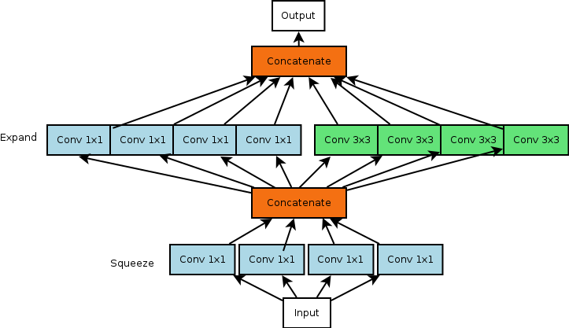
SqueezeNet
Fire Module
Notes:
https://stephan-osterburg.gitbook.io/coding/coding/ml-dl/tensorfow/untitled-2/squeezenet-architecture-design
https://medium.com/@avidrishik/squeezenets-architecture-compressed-neural-network-7741d24ca56f

Slide 13
Advantages of compressed networks:
Smaller CNNs require less communication across servers during distributed training.
Smaller CNNs require less bandwidth to export a new model from the cloud to an remote system (take for example an autonomous car or a home security and threat detection system).
Smaller CNNs are more feasible to deploy on hardware with limited memory.

Slide 14
Contrastive Loss:
Contrastive loss takes the output of the network for a positive example and calculates its distance to an example of the same class and contrasts that with the distance to negative examples.
The convolutional network is trained with a contrastive loss, that minimizes distances between pictures of the same person and maximizes the distance between pictures of different persons.
Notes:
Contrastive Loss: is a popular loss function used highly nowadays, It is a distance-based(pairwise) loss as opposed to more conventional error-prediction losses. This loss is used to learn embeddings in which two similar points have a low Euclidean distance and two dissimilar points have a large Euclidean distance.

Slide 15
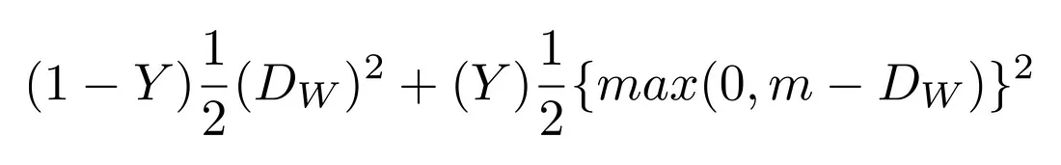

Contrastive Loss:
And we defined D_{w} which is just the Euclidean distance as :
G_{w} is the output of our network for one image.
Notes:
Y = 0 → Similar inputs
Y = 1 → Dissimilar inputs → Negative Pairs
Dw is euclidean distance between pairs squared
If Y = 1 → Similar inputs → Positive Pairs
we need to establish margin i.e. the minimum distance we need dissimilar vectors to be in
Contrastive Loss: is a popular loss function used highly nowadays, It is a distance-based loss as opposed to more conventional error-prediction losses.
After some training, the network is able to map faces into 128-dimensional arrays, such that pictures of the same person are grouped together, while being far from pictures of other persons. This means that, to unlock your device, the network just needs to compute the distance between the picture it takes during the unlocking with the pictures stored during the registration phase. If the distance is under a certain threshold, (the more little it is, the more secure it is) the device unlocks.
https://towardsdatascience.com/contrastive-loss-explaned-159f2d4a87ec

Slide 16
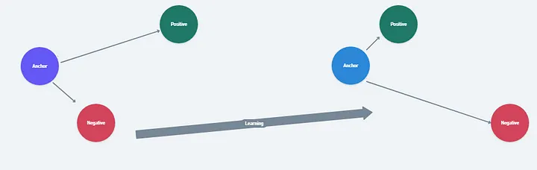
Contrastive Loss:
Notes:
Y = 0 → Similar inputs
Y = 1 → Dissimilar inputs → Negative Pairs
Dw is euclidean distance between pairs squared
If Y = 1 → Similar inputs → Positive Pairs
we need to establish margin i.e. the minimum distance we need dissimilar vectors to be in
Contrastive Loss: is a popular loss function used highly nowadays, It is a distance-based loss as opposed to more conventional error-prediction losses.
Since training of Siamese networks involves pairwise learning usual, Cross entropy loss cannot be used in this case
After some training, the network is able to map faces into 128-dimensional arrays, such that pictures of the same person are grouped together, while being far from pictures of other persons. This means that, to unlock your device, the network just needs to compute the distance between the picture it takes during the unlocking with the pictures stored during the registration phase. If the distance is under a certain threshold, (the more little it is, the more secure it is) the device unlocks.
https://towardsdatascience.com/contrastive-loss-explaned-159f2d4a87ec

Slide 17
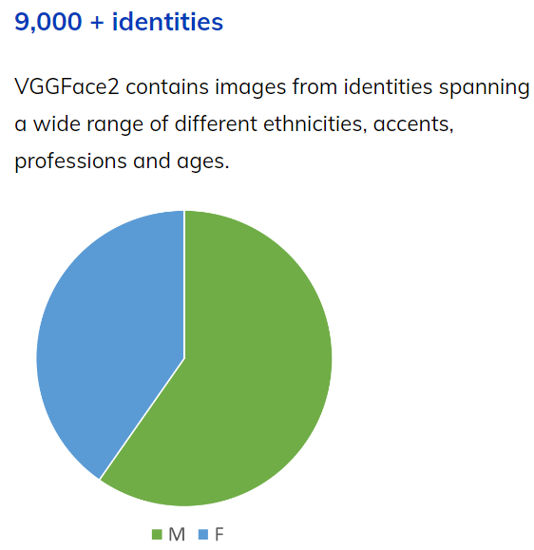
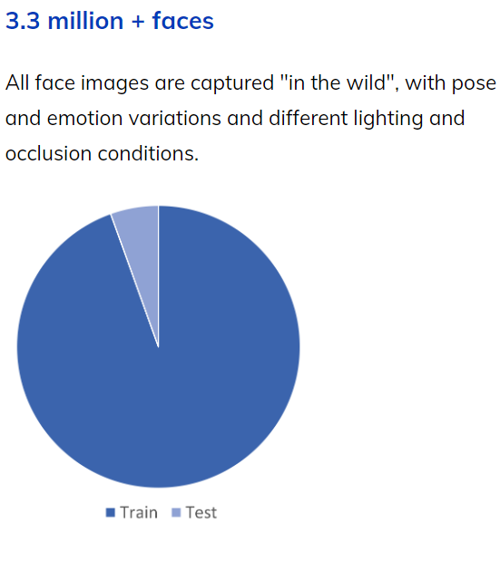
VGGFace2 Dataset:
VGGFace2 is a large-scale face recognition dataset.
Notes:
While constructing the datasets, the authors focused their efforts on reaching a very low label noise and a high pose and age diversity thus, making the VGGFace2 dataset a suitable choice to train state-of-the-art deep learning models on face-related tasks. The images of the training set have an average resolution of 137x180 pixels, with less than 1% at a resolution below 32 pixels

Slide 18
Haar cascade classifier:
After training the model, we need to check whether the given image has a human face or not.
It is done using Object Detection Algorithm.
The algorithm is trained by a lot of positive images (images of faces) and negative images (images without faces).

Slide 19
Steps in deploying the model:
Training the network using VGGFace2 dataset.
Image input ( single image or video)
Detect presence of a face in the Input : Haar Cascade Classifier
Crop the face and input it to the Trained Model to get the Image Vector
For Registration, store the image vector in a database
For identification, find the closest Vector from the database

Slide 20
THANK YOU!!

